Slide 1

H&S and Management
Church of Ss Philip and James, Kings Road, Fleet

Slide 2
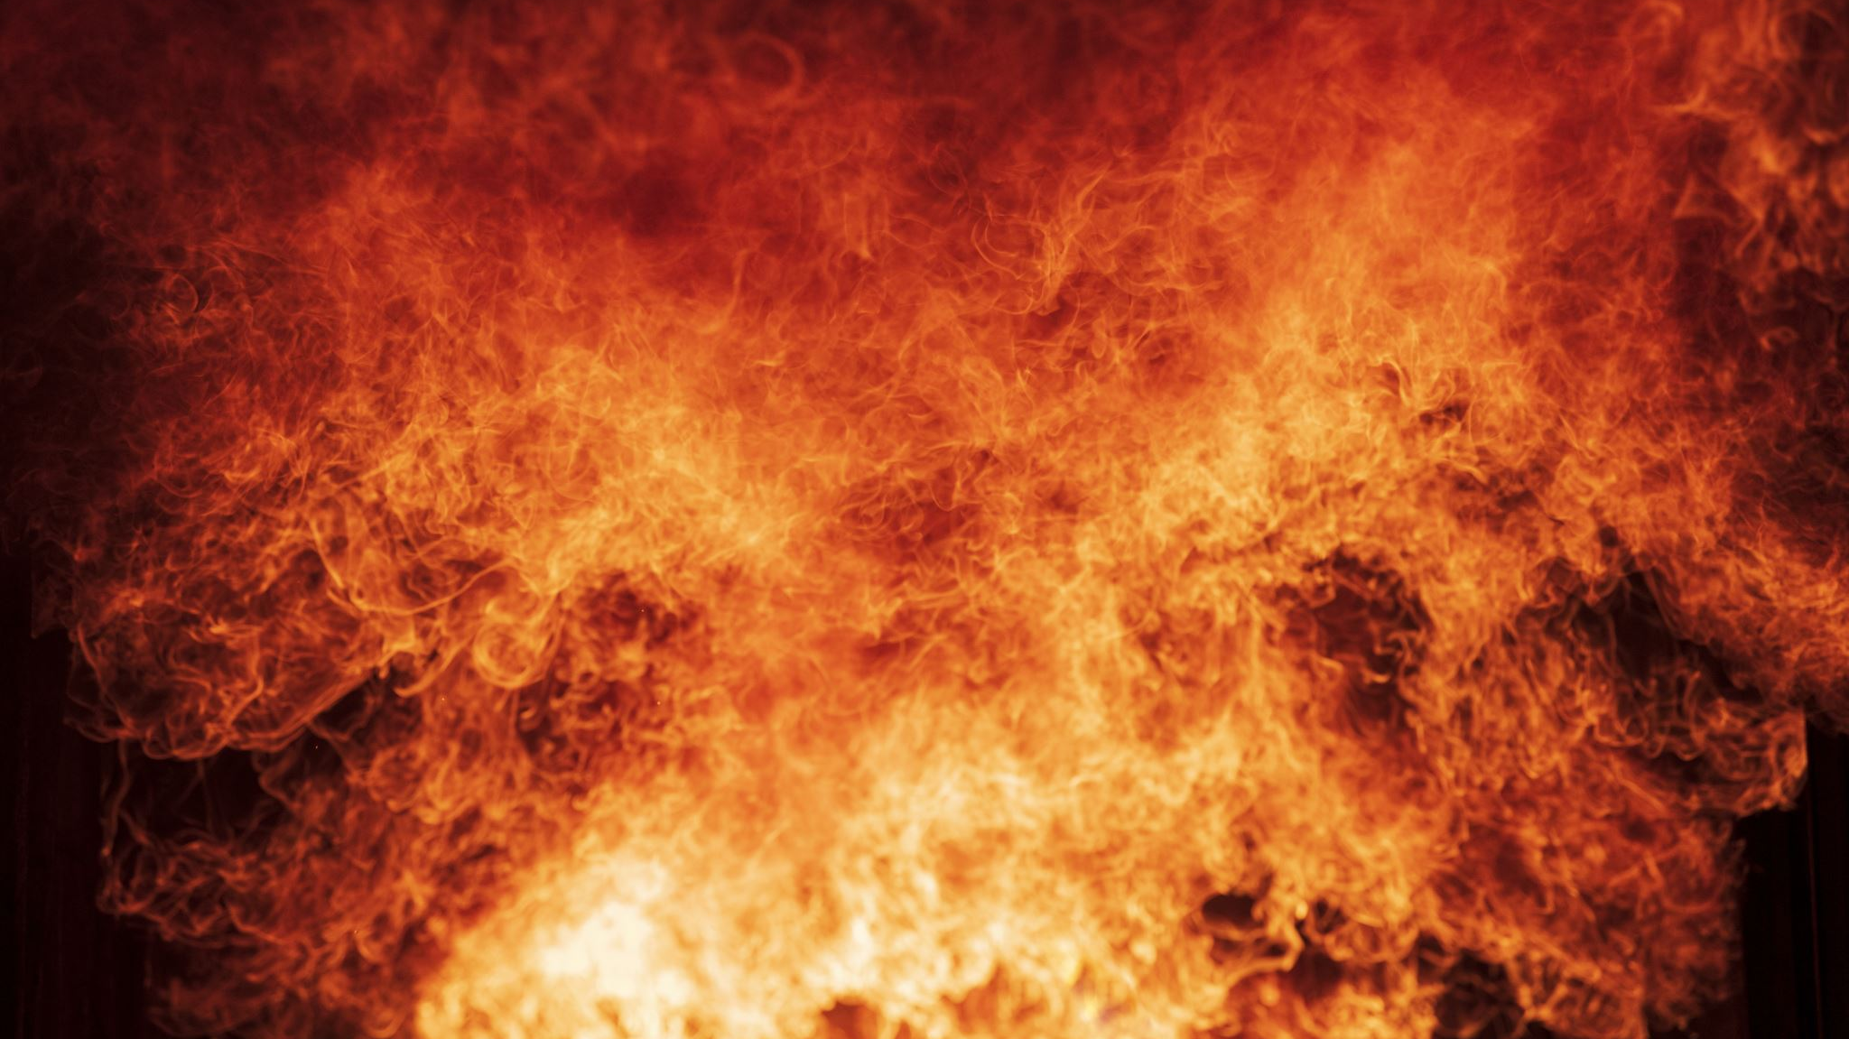
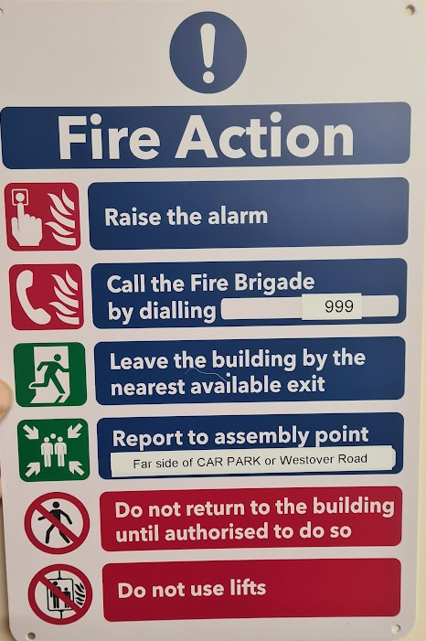
In case of fire
Shout “FIRE!”

Slide 3
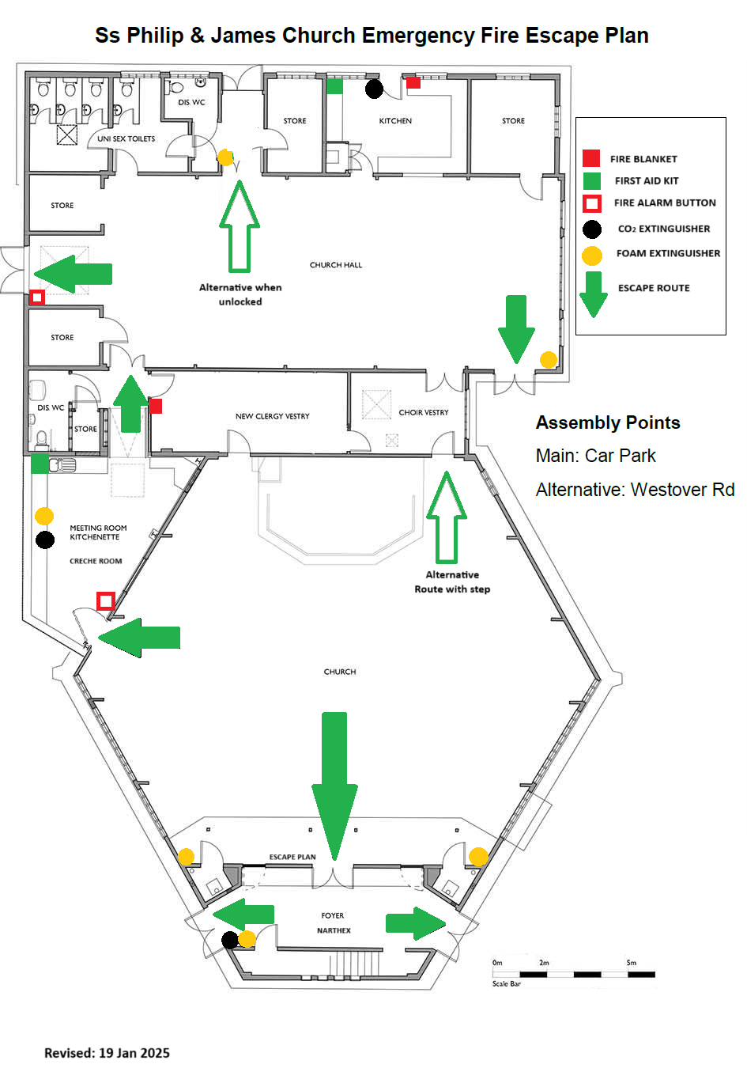

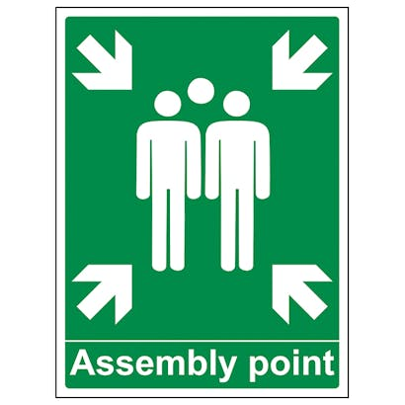
Emergency Fire Escape Plan

Slide 4

Assembly point:
Car park or Westover Road

Slide 5
Fire Policy:
Evacuate!
Do not try to save the building.

Slide 6
However, if safe to use them, there are: fire extinguishers, fire blankets and First Aid kits.

Slide 7

Caution

Slide 8
Do not block access to Fire Exits

Slide 9
Steps

Slide 10
Unlock

Slide 11
In an emergency, unlock (manual thumb-turn)

Slide 12

Management
Please leave the church as you found it:
clean, tidy and with seats in the same place as you found them.
turn the heating down using the instructions.
Please treat the church and its equipment (piano, microphones, altar, furniture, etc) with respect.

Slide 13
Thank you
The Parish of Fleet is delighted that our buildings can be used to serve our community.
You are most welcome!

